Slide 1
OK26 The state sector
Notes:
This PowerPoint has been prepared to help you, as an elected representative, to present the state sector collective agreement settlement to your colleagues and encourage everyone to vote on the result no later than 1 April 2026.

Slide 2
Three-year agreement
Total financial framework of 8.7%
General pay increases amount to 6,37%
Targeted allocations for military personnel in the Danish Armed Forces, the vocational education and training sector, and local pay negotiations
Additional improvements relating to parental leave, leave to care for a sick child, and the flexible choice account
Residual increase: locally agreed pay progression, including seniority-based increments and locally negotiated supplements
 | 1. April 2026 | 1. August 2026 | 1. April 2027 | 1. January 2028 | 1.april 2028 | Total
Agreed general pay increases | 1,73 | 0,65 | 1,83 |  | 2,59 | 6,80
Targeted allocations | 0,21 |  | 0,22 |  |  | 0,43
Funds for other purposes | 0,07 |  | 0,77 | 0,36 |  | 1,20
Adjustment scheme contribution | -0,64 | - | 0,05 | - | -0,04 | -0,63
Estimated residual increase | 0,30 | - | 0,30 |  | 0,30 | 0,90
Total | 2,32 |  | 3,17 |  | 3,21 | 8,70
Notes:
Speakers notes
Real wage growth is expected to improve during the OK26 period, as the inflation forecast for the period is 4.40% (source: Økonomisk Redegørelse).
The total economic framework is 8.7%, and an additional 0.2% (a technical adjustment) has been added due to missing inclusion of flexible payments in parts of the private labour market.
General pay increases of 6.80% in total have been agreed, and these increases will be distributed evenly over the three-year agreement period.
However, even though 6.80% has been agreed, the expectation is that we end up with 6.37%. This is partly because the negative result of the regulation mechanism (-0.63) is deducted, and partly because the technical adjustment (+0.2) is added. 6.80 – 0.63 + 0.2 = 6.37%
We usually have pay adjustments on 1 April and 1 October. In the OK26 period, adjustments will take place on 1 April and—new this time—in August 2026. There are no adjustments in October in this agreement period.
Background Information
In the private sector, the bargaining parties have in recent years agreed on relatively large Flexible Choice Account, and the value of the wage components allocated to these accounts (where employees can choose between salary, pension, or time off) has not previously been included in the general calculation of private wage development for parts of the labour market.
This has now been corrected, which is why an additional 0.2% has been added to the economic framework for OK26.
The regulation mechanism ensures that public and private wages develop in parallel.
The mechanism adjusts by 80%, meaning that if public-sector wages increase more than private-sector wages, public wages will be adjusted downward by 80% of the excess increase received by public employees.

Slide 3

Flexible Choice Account, Flexibility and Senior Employees
The flexible choice account consists of a financial component, the Flexible Choice Salary Account, and separate agreements covering leave entitlements
The Flexible Choice Salary Account is funded through the holiday allowance supplement of 2.3%, special holidays of 2.6%, the senior bonus of 1.0%, and new funds amounting to 0.81%.
Each year, before 1 October, employees may decide how to use their flexible choice funds in the following period (the calendar year):
• Ongoing payout with salary, except for funds from special holidays
• Savings within the calendar year for use when taking time off
• Ongoing pension contributions, except for funds from special holidays
Any funds remaining in the Flexible Choice Account at the end of the flexible choice period (31 December) will be paid out with salary, unless the employee chooses to have the amount paid into their pension scheme
Any unused funds will be paid out upon termination of employment
The scheme takes effect on 1. January 2028.
Notes:
Speakers notes
The new flexible benefits scheme consists of two elements:
A financial account, funded through the special holiday allowance, additional leave days, the senior bonus and 0.81% in new funds agreed as part of OK26.
Separate agreements covering leave entitlements, including the existing additional leave days, the flexible leave day and senior leave.
Some contributions will be transferred to the account on a monthly basis, while other funds, from the additional leave days, will be deposited in the account at the beginning of the year.
Leave days, including what were previously additional leave days, will in future be taken without pay, as the funds are held in the Flexible Choice Salary Account and can be withdrawn from there.
During the flexible benefits period, employees may choose to withdraw an optional amount from the Flexible Choice Salary Account when taking a leave day.
Any unused funds on the account will be paid out at the end of the year, unless the employee chooses to have the amount transferred to their pension scheme. This means that funds cannot be accumulated across multiple years.
The scheme takes effect on 1 January 2028.
Background information (if detailed questions arise)
This is an entirely new scheme, and what has been agreed so far are the overall framework conditions.
There will be plenty of time to clarify the technical details before the scheme enters into force.

Slide 4
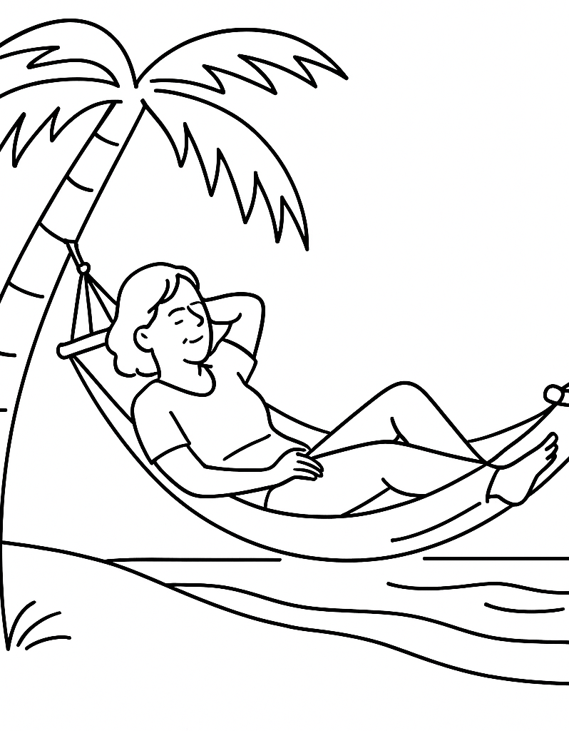
Leave Entitlements
One flexible leave day for employees aged 41 to 61
Two additional senior days from age 62, bringing the total number of senior days to four
The reference period for special holidays will be aligned with the calendar year
Employees may continue to accumulate up to 15 special holidays over time
From 1 September, the employer may schedule special holidays that have not already been scheduled, provided the employee has sufficient funds in their Flexible Choice Account to cover them and has not requested to accrue the days
The right to accrue leave is strengthened:
Employees may continue to accumulate up to 15 special holidays, corresponding to three weeks
The number of overtime hours that may be converted into accumulated leave days under the collective agreement will increase from 74 to 111 hours, corresponding to three weeks.
Notes:
Speakers notes
All leave days under the flexible choice account will be taken without pay, and employees may choose to withdraw an optional amount from the Flexible Choice Salary Account.
Previously, additional leave days were earned during a calendar year, for example in 2025, and could then be taken from 1 May 2026 to 30 April 2027.
In the future days earned in for example 2027 can be taken in the following calendar year,
By agreement, employees may accumulate more than 15 additional leave days.
From 1 September, the employer may schedule additional leave days that have not already been scheduled, provided the employee has sufficient funds in their Flexible Choice Salary Account to cover them and has not requested to accumulate the days.
The leave savings scheme “Agreement on Accumulating Leave” from OK24 has ceased. (This should not be confused with the savings account in pension schemes, which will continue to exist.)
Background information
A transitional arrangement will be introduced for the use of additional leave days until the Flexible Choice Account is fully implemented.
The right to accumulate leave will be strengthened, even though the leave savings scheme from OK24 will be discontinued.
Employees may still accumulate up to 15 additional leave days, corresponding to three weeks.
The number of overtime hours that can be converted into accumulated leave days under the collective agreement will increase from 74 hours to 111 hours, corresponding to three weeks.

Slide 5

Children, Parental Leave, equality and diversity
In addition to the existing entitlement to leave on a child’s first and second sick day, employees will be entitled to paid leave for the remainder of the working day if they are called home to care for a sick child. Plus, paid leave on the child’s third sick day. This improvement takes effect on 1 April 2026
An additional two weeks of paid parental leave will be introduced for parents to share, increasing the total shared leave to eight weeks. This applies to children born or placed for adoption on or after 1 April 2026
Single parents are entitled to 10 additional weeks of paid leave
Paid leave will also be available to social parents and close family members where the mother has transferred her right to absence and parental benefits under the Danish Parental Leave Act.
In addition, several further improvements have been agreed in relation to a child’s hospitalisation, bereavement leave, surrogacy arrangements, and pension contributions during statutory extensions of parental leave.
Notes:
Speakers notes
Leave to care for a sick child remains a possibility if work duties allow. It is therefore not an absolute entitlement. For the negotiators, it was important to ensure that this leave is paid.
(In the private sector leave to care for a sick child beyond the first sick day is linked to flexible benefits schemes. Employees have the right to take leave, but must finance their pay themselves through their flexible benefits funds.)
A number of improvements have been introduced to parental leave rights and other types of family-related leave, including:
Improved entitlement to paid leave for single parents with sole custody.
Paid leave for social parents and close family members, both immediately after the birth or placement of the child (the first 10 weeks) and after the first 10 weeks.
Bereavement leave: up to 12 weeks of paid leave for the surviving parent if the other parent dies before the child turns 18. This improvement will take effect when the Act “Sorgorlov til en efterlevende forælder til et mindreårigt barn” is expected to enter into force on 1 January 2027.

Slide 6
Working Environment and Joint Consultation
At OK26, it is formally established that the prevention of stress is a shared responsibility
The agreement strengthens the focus on stress prevention and the working environment to improve prevention and promote well-being
During the agreement period, the parties will examine the possibilities for establishing cooperation between employers and pension funds aimed at early intervention for employees on long-term sick leave
Knowledge of the psychosocial working environment will be strengthened through management training and a joint conference for managers, health and safety representatives, and union representatives
Work councils (Samarbejdsudvalg) must systematically discuss the workplace’s efforts to identify, prevent and manage work-related stress
The role of the work councils will be strengthened:
• The Cooperation Secretariat will be continued
• A training course will be introduced for management representatives in the work council
• The guidance on management’s duty to provide information will be clarified, with a focus on the introduction and use of new technology, as well as the logging and monitoring of employees

Slide 7

Professional Development and Career Paths
Professional Development
The State Competence Fund and the Competence Secretariat will continue
The Competence Secretariat will further develop its advisory services on the use of artificial intelligence in the performance of work tasks
Career Paths – New Job Category
A new job category, Professional Expert, will be introduced
The salary must be no lower than the bottom of the pay range for Salary Group 1 for state managers - DKK 57,325* per month (April 2026 level)
Salary will be negotiated between management and the individual employee
The employee may choose to be assisted by their trade union
Professional Experts will be covered by the same general terms of employment (e.g. pension, working hours and severance conditions) as Special Consultants and Chief Consultants.
*)subject to final calculation
Notes:
The job category Professional Expert is intended for highly qualified specialists who do not pursue a management career path.

Slide 8

Local Pay Formation
A total of 0.2% of the overall financial framework has been allocated to local pay.
The funds will take effect on 1. April 2027 and must be negotiated locally at each workplace.
It has been agreed that locally negotiated pay outcomes will be monitored over time at ministerial level, at central organisation level, and across staff categories. If the amounts agreed locally fall short of expectations during the agreement period, this will have implications for the next round of collective bargaining in 2029.
Going forward, it will be the employer’s responsibility to ensure that local pay negotiations are conducted at least once a year.
Management must provide relevant pay statistics in advance of the annual local pay negotiations.
The term “one-off payment” will be renamed “bonus.”
Notes:
Speakers notes
The employers wanted a larger share of the salary to be negotiated locally. Our negotiators, on the other hand, took the position that if additional funds were to be allocated to local negotiations, the amount should be kept as limited as possible while ensuring that the funds are actually available at the workplaces and that there is a maximum of transparency in how they are distributed.
The parties have agreed that locally negotiated pay outcomes will be monitored over time, and the 0.2% will be included in the institutions’ price and wage adjustment (P/L regulation).
The funds must be added on top of the pay that is already negotiated locally, so the expectation is that the new funds will increase the share of pay determined through local negotiations.
Local pay formation may be agreed for individual employees, for groups of employees, or through pre-agreed local arrangements.
The term “one-off payment” will be replaced by “bonus”. It will also become possible to agree on retention bonuses, for example in connection with time-limited projects where it is important to retain key employees.

Slide 9
Academic Staff
Increase in Supplements for Associate Professors and Senior Staff
The monthly supplement for Associate Professors, Senior Researchers, Senior Advisers and Senior Project Researchers at universities, the Royal Danish Academy, Design School Kolding, Aarhus School of Architecture, sector research institutions, GEUS, the defence sector, libraries, archives and museums will increase from DKK 9.625* to DKK 9.835* per month (April 2026 level). The supplement is pensionable
Professors – Pay Negotiations and additional Positions in Pay Grade 38
Salary negotiations, including lump sum payments and permanent or temporary supplements, will in the future take place directly between the individual professor and management. The professors may choose to be assisted by their trade union.
The number of professorships in Pay Grade 38 under the Ministry of Higher Education and Science will increase by 50 positions.
*subject to final calculation

Slide 10
Academic Staff (continued)
Supplement for Associate Professors in the Docent Promotion Programme
Under the job structure for teaching staff at higher education institutions including business academies, university colleges, the Danish School of Media and Journalism and maritime educational institutions, it is possible to enter a promotion programme from Associate Professor to Docent
Associate Professors enrolled in the new promotion programme will receive a monthly supplement of DKK 2.950* (April 2026 level). The supplement is pensionable
Collective agreement for external lecturers and part-time lecturers at university colleges and related institutions
Pay and employment terms must be agreed for student instructors at university colleges, the Danish School of Media and Journalism, business academies, and maritime educational institutions.
The intention is that student instructors will be covered by the collective agreement for external lecturers and part-time lecturers at university colleges, the Danish School of Media and Journalism, business academies, and maritime educational institutions under the Ministry of Higher Education and Science.
*subject to final calculation
Notes:
Omit if there are no participants from the sector.
Higher education institutions including business academies, university colleges, the Danish School of Media and Journalism and maritime education and training institutions only.

Slide 11
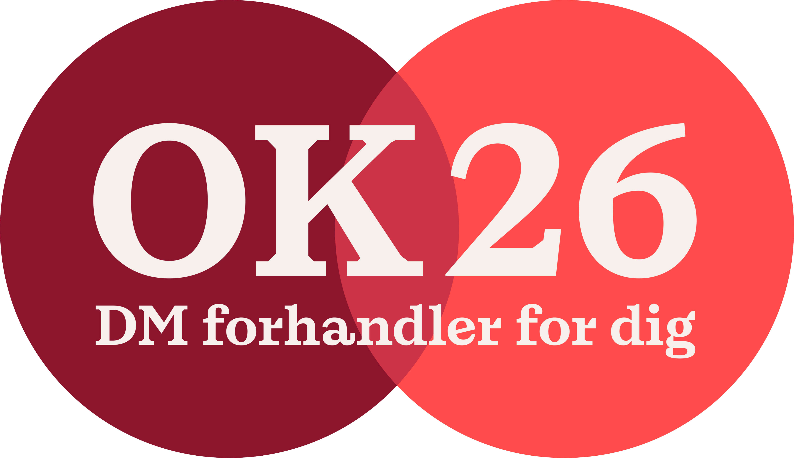

We vote together
We negotiated together. Now we vote together
When we vote, we show that our collective agreement matters. The more of us who participate, the stronger our position is in relation to the employers
If you have not voted yet, use the link in the email sent on 16 March at 11:30 or the text message sent on 17 March at 9:00 and cast your vote now
Whether you vote for or against is your choice. But vote.
Notes:
DM’s Executive Committee recommends a YES vote on OK26 – but the choice is yours. The most important thing is that you vote.
For OK26, DM entered the negotiations with a clear priority: to ensure a noticeable real-wage increase for members and to move working life in a more sustainable and flexible direction.
DM’s Executive Committee considers the overall OK26 results to provide good value for members and to contain clear outcomes that reflect the members’ priorities (wage development, flexibility in working life, and a better balance between work and private life).

