Slide 1
OK24 - The result – the state sector

Slide 2
The settlement in brief
2-year agreement
Financial basis of 8.8 %
Pension
Special holiday allowance
Saving leave
Maternity leave
Skills development
AI
Union representatives
And special improvements for:
- employees in the sciences
- lecturers at university colleges, business academies and maritime programmes
- managers
- specialist and senior consultants in the government ministries
Collective agreement coverage for Astra – the National Centre for Science Education

Slide 3
Finance
Total financial basis of 8.8 %
% | 1 April 2024 | 1 April 2025 | 1 November 2025 | Total
General salary increases | 4.83 | 1.27 | 0.20 | 6.30
Other purposes | 0.11 | 0.89 | - | 1.00
Estimate for the regulatory scheme | 1.06 | 0.04 | - | 1.10
Estimate for remaining increase | 0.00 | 0.40 | - | 0.40
Financial basis | 6.00 | 2.60 | 0.20 | 8.80
Private sector salary estimate |  |  |  | 8.80
Estimated inflation |  |  |  | 4.90
Expected real pay improvement |  |  |  | 3.50
F
Notes:
We have succeeded in getting the bulk of the salary increase at the beginning of the period, so members can make up for some of the real pay loss as quickly as possible following a period of inflation.
“Other purposes” are, for example, increased pension percentage, maternity improvement and supplement increases.
“Estimate for remaining increase” is the parties’ expectation for the local salary development, i.e. both seniority increases and local salary negotiations. This has been set very low so that we can use as much of the financial basis as possible for general salary increases. This does not mean that salaries should not be negotiated locally.
We expect members to achieve a real pay increase of 3.5 % over the period.
The estimate for inflation comes from the Ministry of Finance
The estimate for the regulatory scheme is fixed for 1 April 2024 and an educated guess in relation to the private sector salary development for 1 April 2025, so the adjustment for 1 April 2025 may be changed if the private sector salary development is different than expected.
The negotiation in November 2025 is to work out the private sector salary development and ensure that we do not get an overhang into OK26

Slide 4
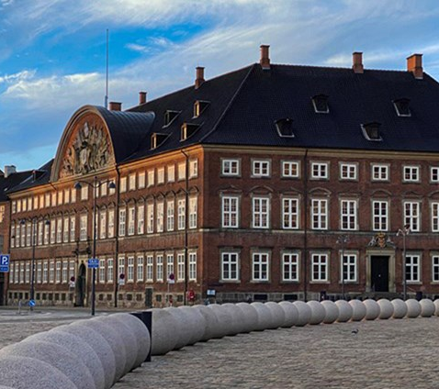
Finance – real pay
Loss of real pay during the OK21 period
Good private sector salary increases in 2023
Lengthy negotiation with the Ministry of Finance on the basis for OK24
The basis was “maxed out”
Improved regulatory scheme with a new pay index
Final negotiation in November 2025
Notes:
It is no secret that we are coming out of the OK21 period with a loss in real pay, and we will not make up for all that loss with OK24, but we will make significant progress.
One of the things that took a really long time to get in place during the OK negotiations with the Ministry of Finance was the financial basis. We could not move on the 8.8, but we could “max” it out by negotiating the price down for the other improvements we got through (e.g. maternity leave), and we could negotiate the estimate for remaining increase all the way down, so there were more funds for general (centrally agreed) salary increases.
The Minister of Finance had some strong forecasts for private sector salary development in the next two years, and according to those forecasts, there was no room for more than 8.8.
The regulatory scheme ensures a link between public and private sector salaries. If private sector salaries increase more than public sector salaries, employees in the public sector will have their salaries adjusted by 80 % of the difference – the same applies if the salaries of public sector employees increase more than those of private sector employees, in which case the salaries of public sector employees will be adjusted downwards by 80 % of the difference. With OK24, we have agreed to move to a new and more accurate pay index, which to a greater extent than the old one ensures that public sector pay mirrors private sector pay (from an implicit to a standardised pay index).
And last but not least: An additional negotiation has been agreed for November 2025, when the parties will look at whether public and private sector salary development has mirrored each other during the OK24 period, or whether adjustments need to be made. This is to ensure that public sector salaries do not lag behind if things go better than expected in the private labour market – and it was essential for us to accept a financial basis of 8.8 because if the Ministry of Finance’s forecast is too pessimistic, then we will be able to make a correction with the “end-of-year negotiation” at the end of the agreement period if it turns out that we have received too little.

Slide 5
Finance – continued
Special holiday allowance
- The special holiday allowance will be increased from 1.5 % to 2.02 % with effect from 1 April 2024. At the same time separate payment of the supplement for Great Prayer Day, which was 0.45 %, will end.
The pension percentage will be increased from 17.1 % to 18.07 % from 1 April 2025
Notes:
The payment for Great Prayer Day will be combined with the special holiday allowance (which is typically paid out along with the May and August salary payments). At the same time, the special holiday allowance is revalued by 0.07. In total, the special holiday allowance will increase by 0.52 %. The special holiday allowance is not included when the regulatory scheme is calculated. This means that the increase in special holiday allowance will not count as a salary increase when we calculate the regulatory scheme.
The pension will increase by 0.97 %.

Slide 6
Pension and savings scheme
Employees can choose to receive the part of the pension contribution that exceeds 15 % and all/parts of the pension contribution on the general supplement (12.5 %) paid as salary or paid into a savings scheme in the pension fund.
The change comes into force on 1 April 2025, when the pension percentage will increase from 17.1 to 18.07.
The savings scheme will allow greater flexibility for saving over a long working life
Notes:
There is no restriction on the purpose of the funds saved. The advantage of saving in the pension fund is that you can achieve a good return and the employer is responsible for the deposits.
The savings scheme – deposited after tax, in return tax-free when you withdraw it
There is no right to leave associated with the savings, but this can be agreed with the employer
Better return than saving in your own bank account – it is only the customers who own the pension fund and get the full return (not shareholders)

Slide 7
Saving leave
It is possible to save leave for additional work and special holiday days for later use
Leave of up to 15 days in total can be saved, including a maximum of 8 days from earned additional work
The change comes into force on 1 May 2025
Notes:
Employees can plan to take up to a maximum of 8 of their saved days annually and no more than two consecutive days. Employees must provide as much advance notice as possible when taking these days, and days can be taken to the extent work permits. I.e. employers must have a good reason for refusing (in accordance with the Holiday Act) - If the employee wishes to take more than 2 consecutive days or more than 8 days in a year, this must be agreed with the employer. If, for instance, you have saved 15 days and want to take them at the end of the summer holiday, this must be agreed with the employer.
Upon leaving, cash compensation, so the employer cannot ask for the saved days to be taken.
It has always been possible in the holiday agreement to agree on the transfer of the 5 special holiday days to the next holiday year. However, it required an agreement between the employer and employee. With the new agreement, there is now a right to save special holiday days (you do not need to agree this with your employer) and you can save them for several years.
Note the date this comes into force – it follows the time for allocation of new special holiday days.

Slide 8
Maternity leave
3 weeks of extra right to salary for all co-parents. This enables families to make better use of the ear-marked maternity leave in the new maternity leave rules, if they now receive salary for the entire period
With these new weeks, the right to salary for co-parents is as follows:
2 weeks in association with the birth
Then 10 ear-marked weeks + 6 shared weeks (during the period 10 weeks after the birth)
In addition, we have secured an improved right to salary for multiple-birth parents and single parents
The changes come into force for children born on or after 1 April 2024
Notes:
It is very positive (equality) that we have now guaranteed more weeks of paid maternity leave for fathers and non-birth mothers. We know that pay is a huge factor in deciding whether partners take maternity leave, and we expect that even more people will use the entire ear-marked maternity leave period now that employees in the public sector are entitled to full pay.
Multiple-birth parents will each receive 13 weeks extra. This also applies to adopting parents if the children are under the age of 1 year when they are adopted
Single parents will receive 10 extra weeks. This also applies for adoption
Mothers (as designated in the Maternity Leave Act) are still entitled to salary for 6 weeks before the birth, 14 weeks after the birth (maternity leave) + 6 weeks (parental leave) + 6 shared weeks, which must be shared with the other parent if both parents are employed on the same agreement.

Slide 9
Skills development and management training
The State Sector Competence Fund and the Secretariat for Competence Development will continue
Continuation of the voluntary management training in psychological working environment (FLIPA)
Notes:
The State Sector Competence Fund and the Secretariat for Competence Development will continue with a financial basis equivalent to the result in 2021, upgraded to the OK24 level
The parties will strengthen the shared understanding of strategic skills development in the Secretariat for Competence Development’s advisory services
FLIPA will continue its current arrangements with 3 full training days + 2 half networking days within six months. Managers’ participation will be financed by their workplaces

Slide 10
Artificial intelligence (AI)
The parties are agreed on the launch of a multi-track approach during the agreement period. This will form the basis for discussions of relevant agreements and contribute to the implementation and use of artificial intelligence in public sector workplaces in an appropriate manner.
In concrete terms, the parties will:
In partnership, acquire new knowledge of AI
Discuss the need to adjust the relevant central agreements. The goal is to clarify how the parties can best support local discussions and the potential and risks of AI in agreement terms
In partnership, encourage and promote dialogue on AI at public sector workplaces, e.g. through a shared dialogue tool for local discussions of implementation and use of AI
Notes:
The agreement on dialogue on the use of AI in workplaces is, in many ways, similar to the agreement we reached for OK21, which ensured that employees had some influence on the green transition in the workplace. It is important that there are local discussions when the workplaces need to transition, whether this is due to organisational changes or new technology, so that the employees’ perspective and daily life are considered in the solutions that are agreed upon.
For example, expert presentations can be arranged on technologies based on AI and their implications for the future labour market, workplace visits with a focus on best practice, as well as knowledge and experience exchange. The discussions will strengthen the foundation for the further dialogue on visions and boundaries for AI.

Slide 11
Union representatives
At institutions with geographically dispersed locations or staff groups of over 100 employees, there will be a renegotiation of the union representative structure and the number of representatives per staff group if one of the parties so wishes
The change comes into force on 1 April 2025.
As of 1 April 2024 the following applies:
The union representative must be able to meet with newly employed colleagues during working hours
Following election or re-election of a union representative, the management and representative will discuss how much time will be required for the role and whether ordinary duties will need to be reduced (shared responsibility)
Continuation of Samarbejdssekretariatet
Notes:
The common factor for the three changes is that they improve the union representative’s ability to carry out their duties. Thanks to the agreement on number and geography, it is possible to elect more union representatives so that they can maintain better contact with their colleagues.
The contact with newly employed colleagues is important, because it allows the representative to explain about the union and professional life, and possibly to encourage non-union members to join.
The time required, and in particular management’s duty to take into account the need for reduction of ordinary duties, are also a step in the right direction, as it ensures union representatives have the necessary time/space for their duties.
The aim of Samarbejdssekretariatet is to promote the work of cooperation committees in public sector workplaces

Slide 12
Special improvements

Slide 13
University colleges, business academies and maritime programmes
Agreement coverage for part-time teachers and external lecturers
Even workload
The right of research students to return to a position as an assistant professor or lecturer following a period of employment as a research student
Notes:
In addition to agreement coverage, the agreement also comes with a number of concrete improvements in terms and conditions, e.g. in connection with pay during illness, maternity leave, and a child’s 1st and 2nd sick day. The agreement introduces the option to enter into an agreement for a supplement in excess of the hourly pay for part-time teachers and external lecturers, as well as improved periods of notice on termination. Finally, the agreement includes improved remuneration for part-time teachers at business academies who teach on academy programmes.
Agreement has been reached to specify the conditions for distributing workload evenly, enabling discussions to be held on the need for changes to the range of duties in order to safeguard the link between duties and hours if the total number of hours worked exceeds by one quarter the normal average per week.
The agreed specification means that it is now completely clear that research students at university colleges, business academies, etc. are entitled to return to a position as an associate professor or lecturer when their period of employment as a research student ends.

Slide 14
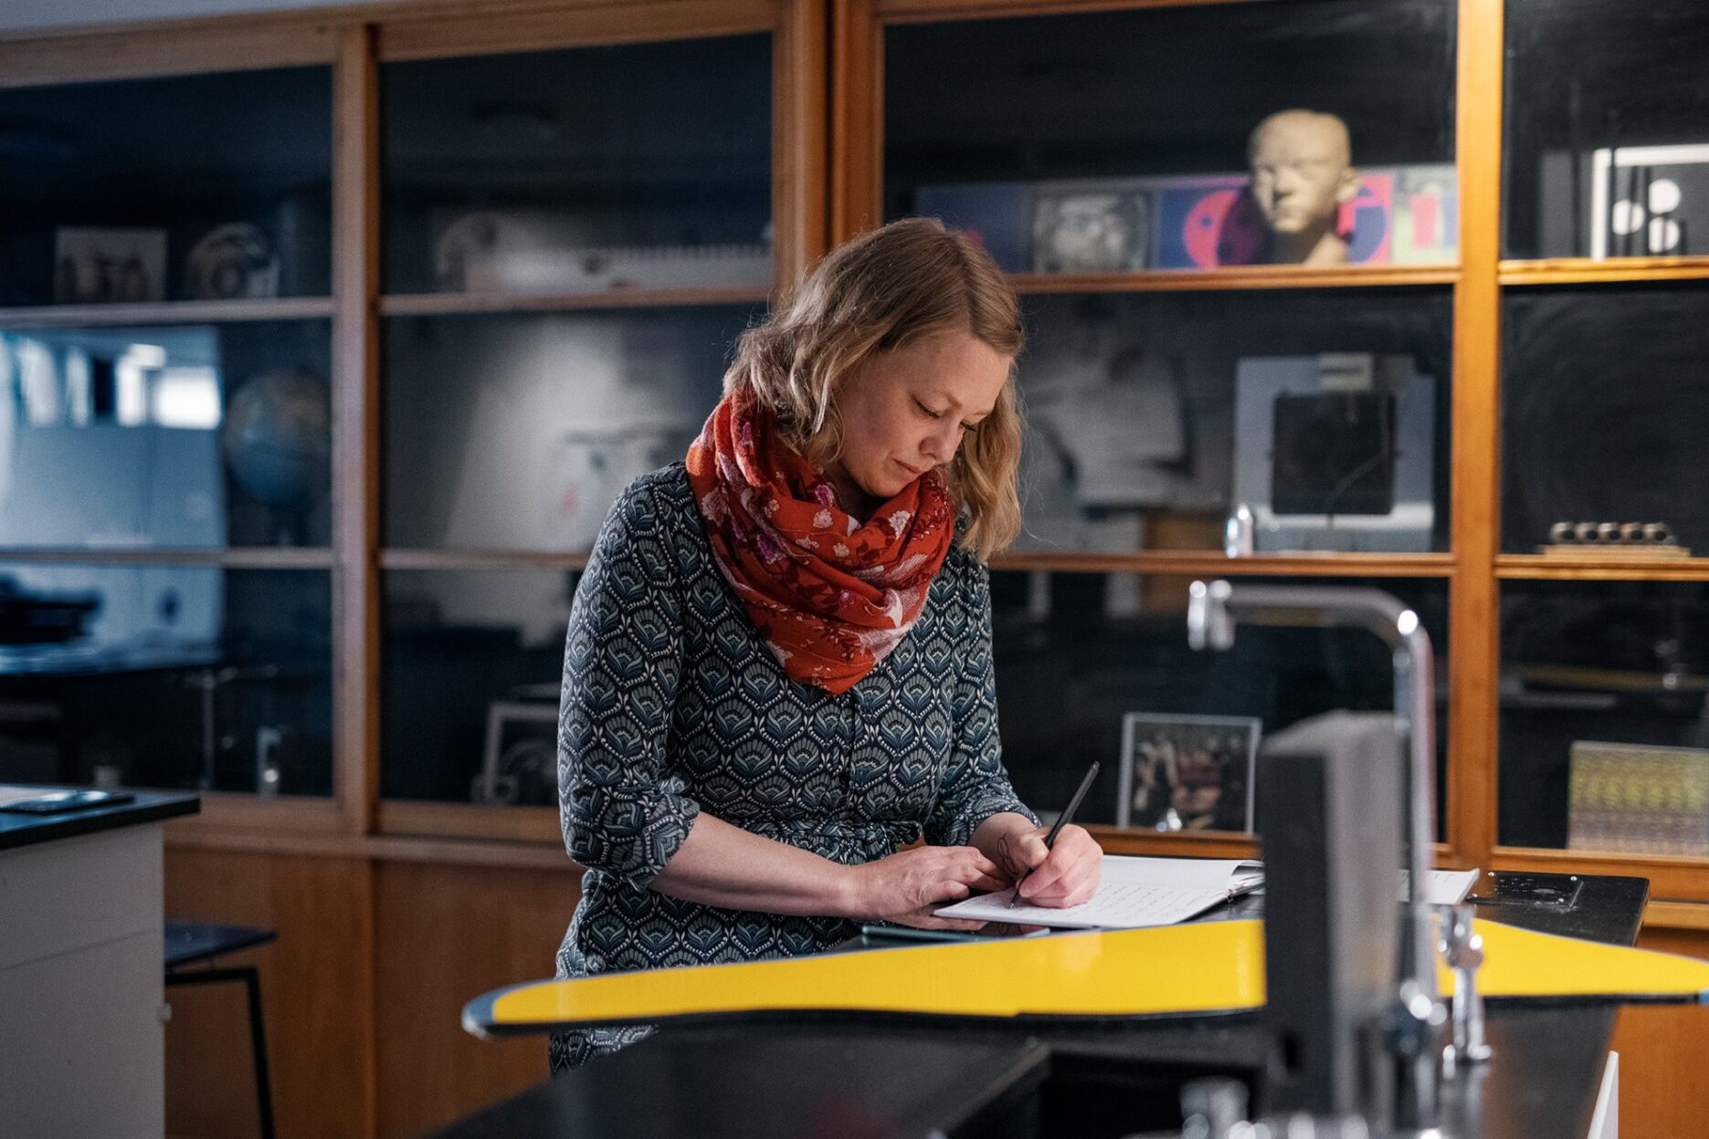
Employees in the sciences
Improved salary progression for researchers/lecturers with overseas qualifications, who are employed in positions requiring a PhD-level degree at universities, institutions of higher education and research institutions
Improved salary progression for PhD students employed on the basis of an overseas academic qualification
Better possibilities for extension for PhD fellows and research students
All improvements come into force on 1 April 2025
Notes:
Researchers/lecturers with overseas qualifications, who have a PhD degree and are employed in positions requiring a PhD-level degree at universities, institutions of higher education and research institutions, will be assigned to the same salary progression as their colleagues with a Danish master’s degree. The parties agree that any local supplements granted to compensate for the difference in the basic salary can be offset against the reclassification of existing employees.
PhD students who are employed on the basis of an overseas academic qualification will be assigned to the same salary progression as their colleagues with a Danish master’s degree.
The ability of PhD students, following specific assessment, to secure an extended period of employment owing to wholly exceptional and individual circumstances that could not have been foreseen and that cannot be attributed to the person concerned themselves. This may include, for instance, loss of data or challenges associated with a stay abroad.

Slide 15
Employees in the sciences – continued
GEUS has the same option as universities to employ researchers in permanent tenure-track positions and to offer senior researchers employment in a programme for promotion to professor
KADK, Aarhus School of Architecture and Design School Kolding now also have the same option as universities to offer lecturers employment in a programme for promotion to professor
It has been agreed that senior researchers/lecturers who are included in a programme for promotion to professor at the above institutions will be granted a supplement in addition to the lecturer’s supplement of DKK 52,670 annually. The supplement is pensionable. These are the same salary terms that apply to the promotion programme at universities
At KADK, Aarhus School of Architecture and Design School Kolding, a new job category of artistic professor has been introduced, which replaces the job category professor MSO. Salary and other terms of employment as artistic professor are equivalent to the terms for professor MSO
The Royal Danish Defence College will get a job structure more on a par with universities.
The Danish Veteran Centre’s Knowledge Centre now has a job structure with academic career paths on a par with universities
All improvements come into force on 1 April 2025
Notes:
It will now be possible for GEUS to employ researchers in permanent positions in a tenure-track progression with transition to a senior researcher position, and it will also be possible to offer senior researchers the programme for promotion to professor. This is the same model that was introduced at universities a few years ago, and we see it as a clear enhancement of career opportunities and an opportunity to move away from widespread use of fixed-term positions.
KADK = The Royal Danish Academy – Architecture, Design, Conservation
The Royal Danish Defence College has now introduced the following positions: academic assistant, postdoc, professor, PhD fellow and external lecturer. Salary terms and terms of employment for the new job categories have been agreed at the same level that applies at universities.
An academic job structure has been introduced at the Danish Veteran Centre’s Knowledge Centre that is on a par with universities. This means that the following job categories are being introduced: academic assistant, PhD fellow, postdoc, researcher and senior researcher, and that salary and terms of employment follow the same levels as applicable to equivalent positions at universities. A transitional arrangement has been agreed, under which existing employees with academic qualifications can choose to transfer directly to a position covered by the job structure and the agreed terms.

Slide 16
Music academies and performing arts schools
Researchers and lecturers at music academies and performing arts schools will receive an increase in supplement levels for assistant professors and associate professors as well as teaching assistant professors and teaching associate professors, who are employed in positions covered by the job structure. This means an annual increase of: - DKK 5,796 in the assistant professor supplement, - DKK 18,711 in the associate professor supplement, - DKK 11,244 in the teaching assistant professor supplement - DKK 5,680 in the teaching associate professor supplement after three years (all figures in “current value” and the supplements are pensionable)
Guarantee of right to extension in the event of maternity leave and adoption for assistant professors at music academies
All improvements come into force on 1 April 2025
Notes:
The music academies and performing arts schools have long been a focus area for DM in collective agreement negotiations because the supplement levels in the job structure are lower than at the universities.
With this improvement, we have just about achieved the same level of supplements as at universities, but with a decent improvement compared to the previous terms for
assistant professors on maternity leave at music academies. The outcome means that we have clarified and secured a legal entitlement in the agreement, so that assistant professors at music academies now have the exact same rights to obtain an extension to the period of employment in the event of maternity leave and adoption as in all comparable fields.

Slide 17
Government ministries
Specialist and senior consultants in the government ministries will get an annual supplement of DKK 20,000, in the annual basic sum 31 March 2012, which gives DKK 23,184 in “current value”
The improvement comes into force on 1 April 2025
Notes:
The supplement will strengthen recruitment and retention in the government ministries. This has NOTHING to do with pressure of work and additional work

Slide 18
Managers
Managers in fixed-term positions employed in accordance with the Framework agreement on contractual employment of managers in the public sector will be guaranteed the right to severance pay if they are dismissed during the fixed-term period
The basis salary will be raised for managers in pay groups 1 and 2 in the Framework agreement on contractual employment of managers in the public sector: - The salary interval for pay group 1 will be raised by DKK 10,518 annually (current value) at the bottom of the interval - The salary interval for pay group 2 will be raised by DKK 26,293 annually (current value) at the bottom of the interval
Managers employed at the self-governing institution ASTRA will be covered by the Framework agreement on contractual employment of managers in the public sector
The voluntary management training in psychological working environment will continue
The changes will take effect from 1 April 2024.
Notes:
Re 1: This means that in the event of unsolicited dismissal during the fixed-term period, you will not be placed at a disadvantage compared to permanently employed managers unless you are guaranteed permanent employment in the event of dismissal from the fixed-term position

Slide 19
Voting on the result
Voting among all members of DM employed by the state, region or municipalities during the period 11-24 March
During the voting period, we will – as always – be happy to come to branch meetings
The results of the vote will be announced on 15 April once all Danish Confederation of Professional Association organisations have finished voting
Notes:
It is important that we get a high voter turnout to demonstrate the legitimacy of the agreement. We need to show the employers that the agreement is important to our members so that we can have greater impact at future negotiations.
The greater the support DM receives from members and in voter turnout, the strong DM is. And achieving good results requires strength.

