Slide 1
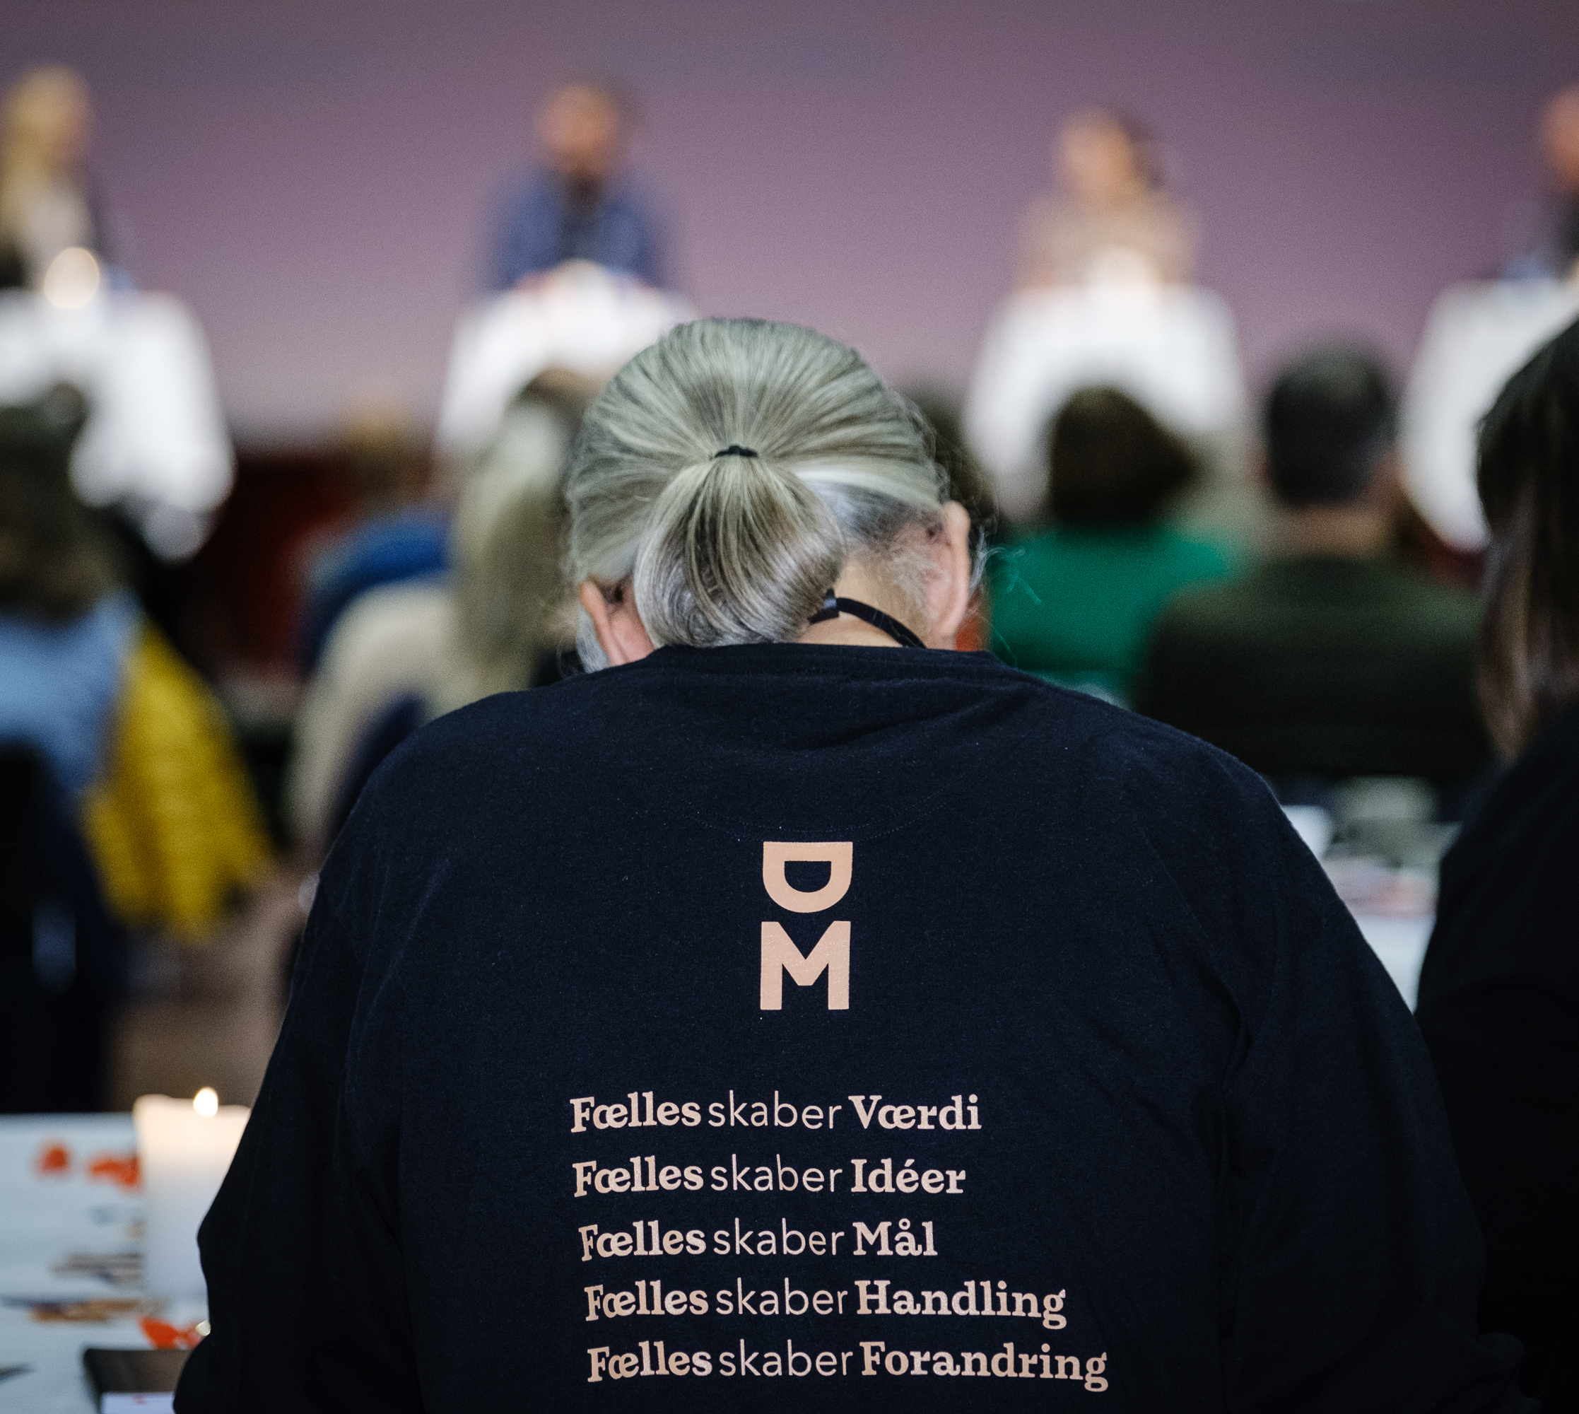
OK24 Presentation for club meetings – participate in the debate so that we set the right requirements for the collective bargaining negotiations
Notes:
Note to presenter: You don't have to go through the presentation from end to end, you can jump around the themes according to where the participants find the most energy in the discussion. It would be good if some participants at the meeting note down the main points from the discussions, so that there is feedback from your discussions to DM. You don't have to think about formulating actual collective bargaining demands. The important thing is that the issues that concern you at work are reported to DM at www.dm.dk/raad-og-svar/ansaettelse/overenskomster/ok24

Slide 2
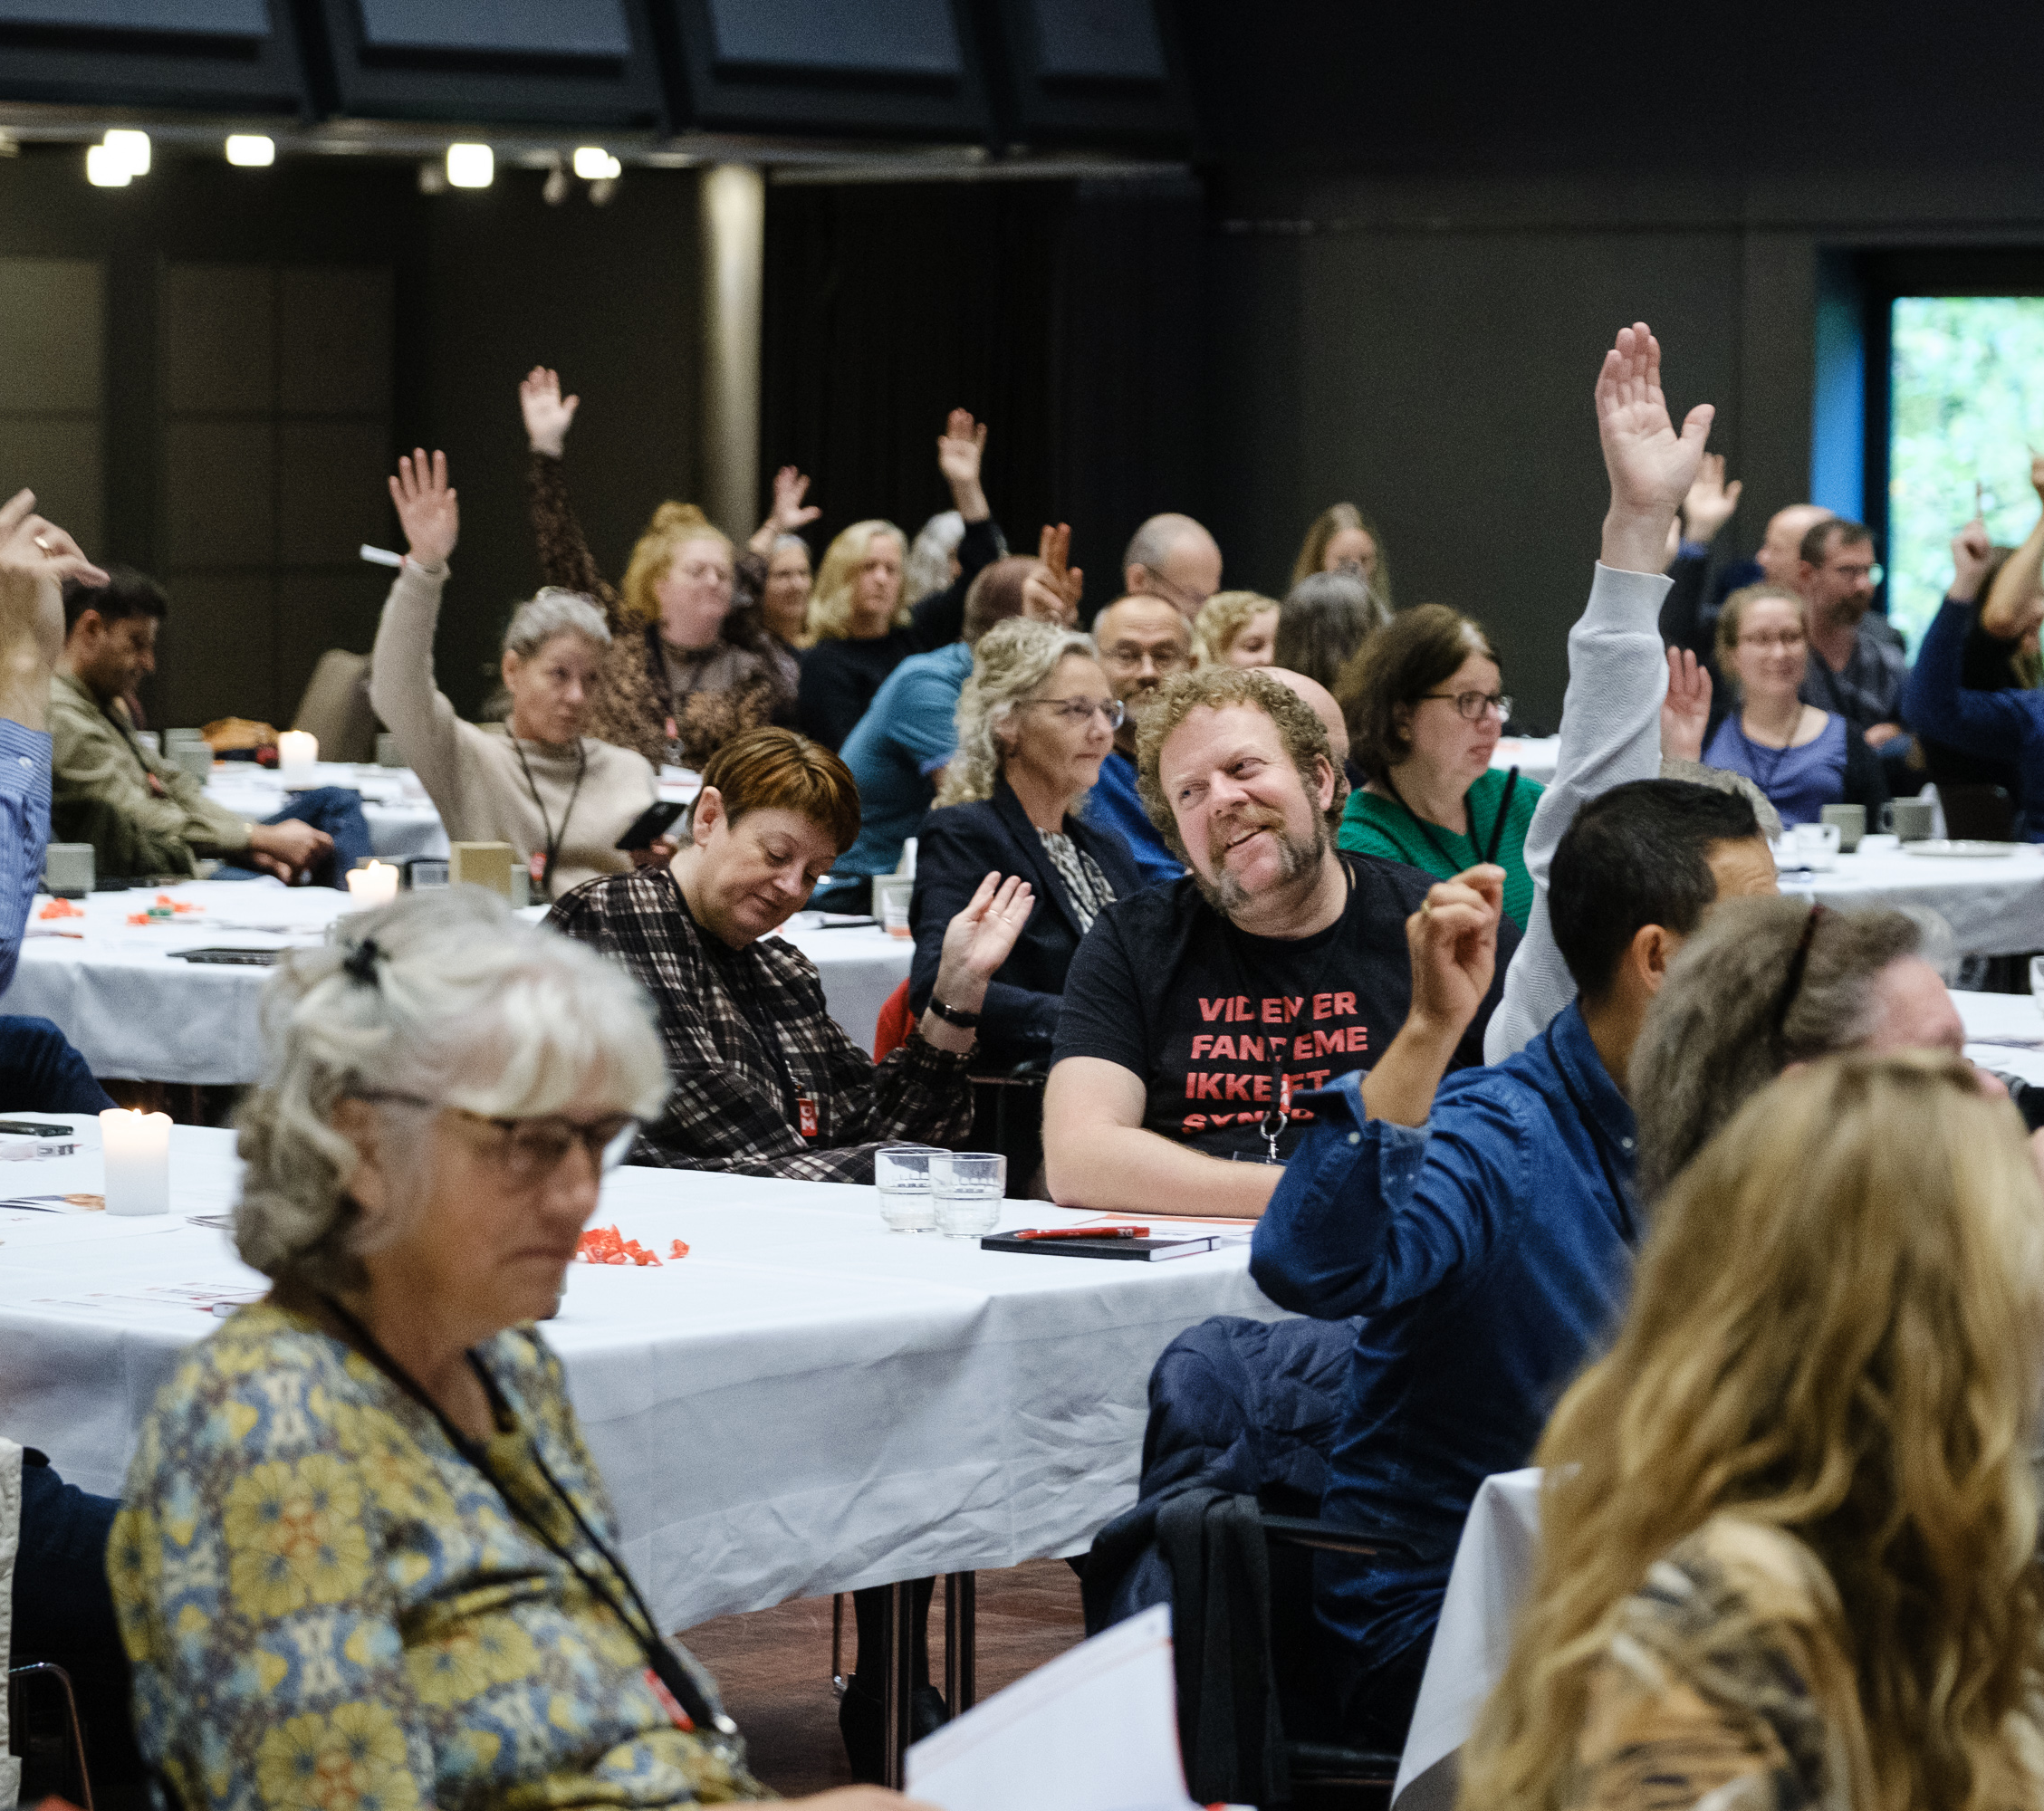
The themes for OK24 – Attractive conditions in the public sector
Wages and local wage negotiations
Influence on one’s own work life
Working environment
Room for professionalism
Co-involvement and transition processes
Job and career development
Conditions for fixed-term employees
Terms and conditions for managers
Parental leave and equality
Terms and conditions for seniors
Notes:
Collective bargaining must help to ensure an attractive public sector labour market, so that skilled employees can continue to be retained and recruited to further develop our society. That is why we put the heading "Attractive terms in the public sector" on our presentation to OK24. Because it’s precisely when there are crises in both the climate and the economy that it is important to have a well-functioning public sector. And in order for DM to make the right demands for OK24, it is important to get input from the workplaces. Here are some suggestions for discussion. Address the themes that are important in the workplace and make additions if anything is missing.

Slide 3
The members' top 5
Wages
Flexibility in work life
Working environment
Conditions for fixed-term employees
Competence development and development opportunities in the job
Notes:
We have started the collective bargaining process by asking DM’s members what is most important to secure in the collective agreements. This feedback has been the basis for DM's discussion paper for OK24.

Slide 4

Wages
DM's member survey shows that our members consider it important that the collective bargaining ensures real wage growth for everyone.
DM believes that the public sector wage development must follow the private wage development, and that this must be ensured through a collective agreement framework that follows the private wage development. Real wage development must be secured through the percentage wage increases agreed in the collective bargaining.
Notes:
Public sector wages are determined partly by wage increases agreed through collective bargaining and partly by local wage negotiations in workplaces. Wages are of particular interest at a time of inflation, so there is no doubt that a lot of attention will be paid to the wage issue at OK24.

Slide 5
Local wage negotiation
DM's member survey shows that the members believe that there is a need to strengthen the influence of the union representatives in local wage formation.
DM believes that the wage system must provide the opportunity for workplaces to work with wages in a way that gives meaning and satisfaction locally, and that this requires a strengthening of the trade union representatives' influence and access to information.
Presentation for discussion:
Is the local wage formation perceived as fair?
Is there a need to adjust the framework for wage negotiations – and if so, how?
Notes:
It is challenging that the local wage negotiations are not sufficiently prioritised and utilised in all workplaces. This means that employees in workplaces where local wage negotiations are not prioritised and utilised sufficiently, will fall behind in terms of wages.

Slide 6
Influence on one’s own work life
DM's member survey shows that the members want a greater degree of influence on their own working hours, including flexible options for working from home.
DM believes that it must be possible to arrange working life more flexibly and that the dialogue at the individual workplace is important in relation to agreeing how flexibility should be implemented in your workplace.
Notes:
DM strives to achieve a sustainable and flexible work life. We recommend that workplaces examine the possibilities for flexibility that suit the working community, the individual and the tasks that the workplace has to perform. This could be:
Flexible organisation of working hours
Possibility of remote work and days working from home
A 4-day working week with either reduced hours or longer working days
Possibility of reduced working hours with shorter working days
Personal choice account
Or combinations of some of these options. In other words, models that can accommodate several different options for flexibility.

Slide 7
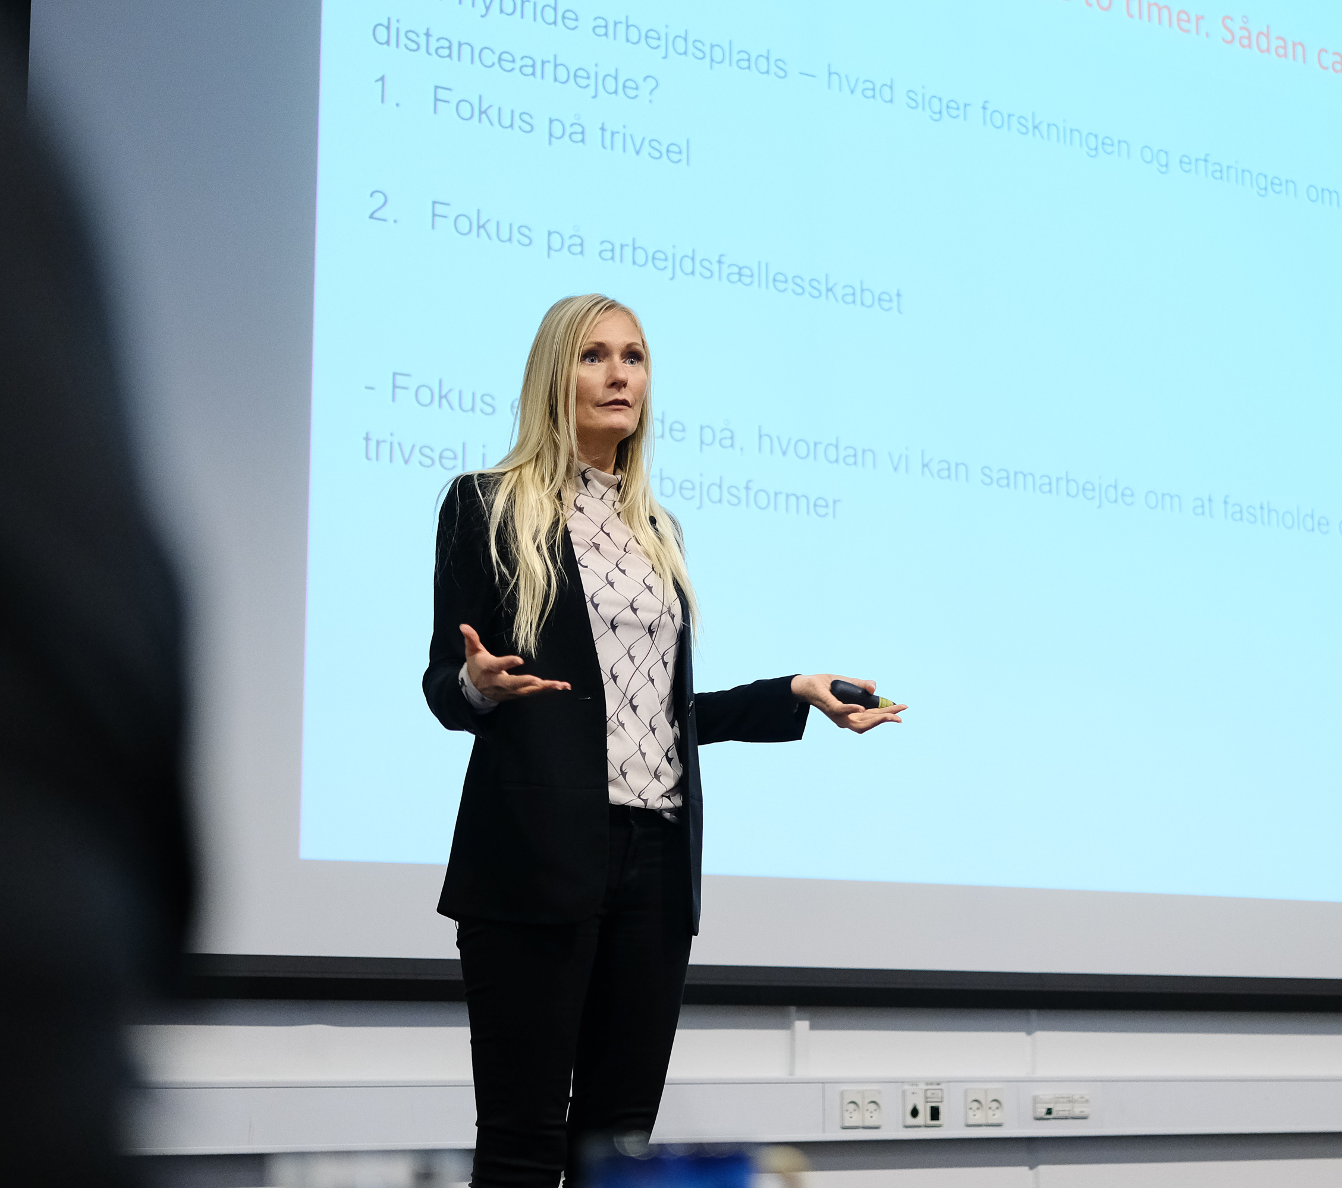
Influence on one’s own work life (continued)
Presentation for discussion:
What are the possibilities at your workplace to satisfy different needs for flexibility?
What are the barriers to a greater degree of flexibility?
What types of flexibility are important to you? How do we avoid work becoming completely limitless and impinging on our free time?
What do we need to make central agreements about?

Slide 8
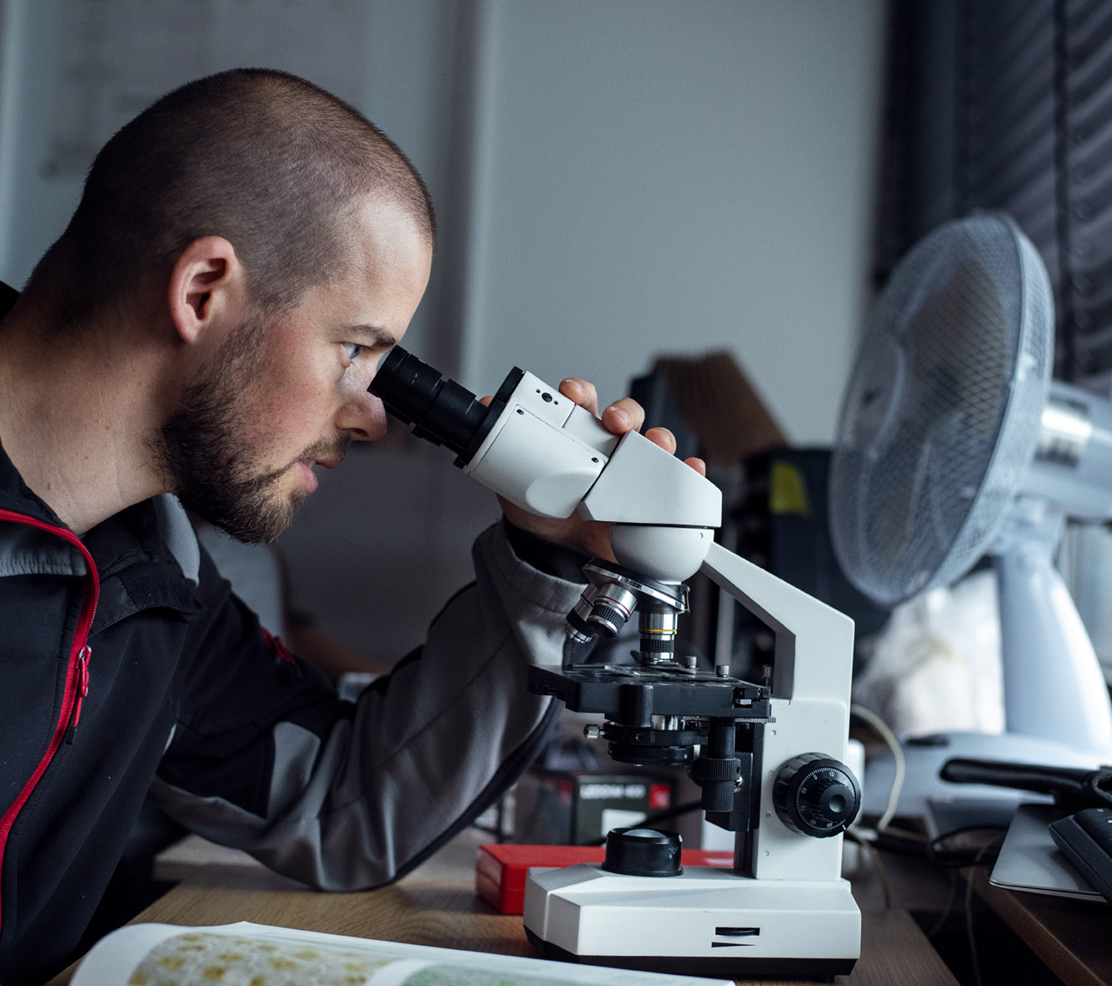
Working environment
DM's member survey shows that the working environment is among the highest priority themes for DM's members.
DM believes that the best psychological working environment is achieved when the framework for work and its organisation is based on constructive dialogue and cooperation between its members, union representatives and managers.
Presentation for discussion:
How can we ensure that the working environment is managed as a shared challenge in the workplace, so that stress prevention, measurement and follow-up are embedded in the organisation?
How do you experience the workload?
What can we do about the increased work pressure?
Notes:
DM assumes that a good working environment is the responsibility of the workplace, not of the individual employee.
The working environment must not be an individual problem, but that of the workplace. It is in the interest of the management, the employees and society generally that psychological and physical overload and illness are avoided.

Slide 9
Room for professionalism
DM's member survey shows that the members feel that there is a lack of coherence between the workplace's tasks and resources.
DM believes that there is a need to articulate the respect for members' professionalism and education that underpins core services and operations.
Presentation for discussion:
Where do you see professionalism being challenged?
What is challenging your professionalism?
What challenges do you see in relation to the development of the core tasks?
Notes:
There are several factors at play when members feel that professionalism is under pressure. There is both the time needed to carry out tasks properly and the necessary respect for professional judgement.

Slide 10
Co-involvement and transition processes
DM's member survey shows that the members see a need to strengthen the trade union representatives' opportunities to influence decisions at the workplace, both in terms of resources and organisational changes, but also in relation to wages and working hours.
DM believes that there is a need to strengthen the influence of union representatives generally, in order to broaden the negotiating agenda locally. The central collective bargaining parties must focus on securing the right framework, so that local partners in workplaces can find the solutions within the framework that are appropriate for local conditions.
Notes:
It is important that employees are involved and consulted in all relevant change processes in the workplace, because this leads to co-ownership and better solutions. The changes may be based on the environment, the economy, digitalisation or restructuring
OK21 included a provision that employees and SU/MED shall have influence on the green transition of the workplace. In addition to the green transition, a broader agenda for workplace negotiations could include e.g. digital transformation, ethics and gender equality. The digital transformation opens up new ways of working, new ways of organizing work, but also new opportunities for monitoring employees, which must be avoided to a large extent, and about which it is necessary to ensure local dialogue.

Slide 11
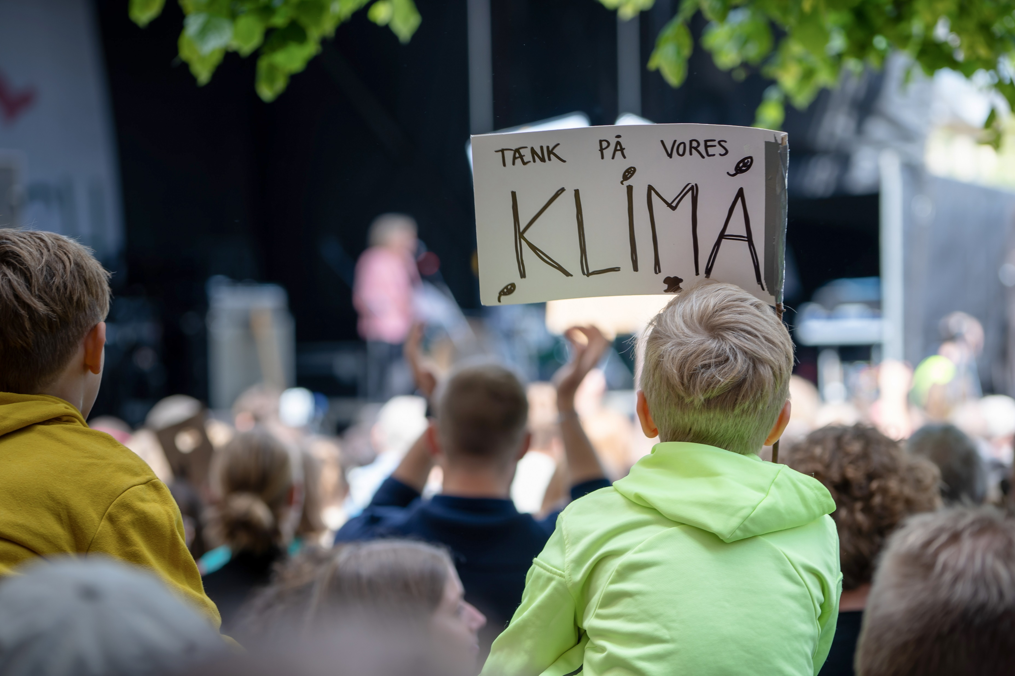
Co-involvement and transition processes (continued)
Presentation for discussion:
What opportunities do you see to strengthen the trade union representatives' influence in the workplace?
What issues are important for you to discuss in the context of the green transition?
Does the digital transformation entail a special need for influence on your part?
Are there other agendas in your organisation where increased participation is important?

Slide 12
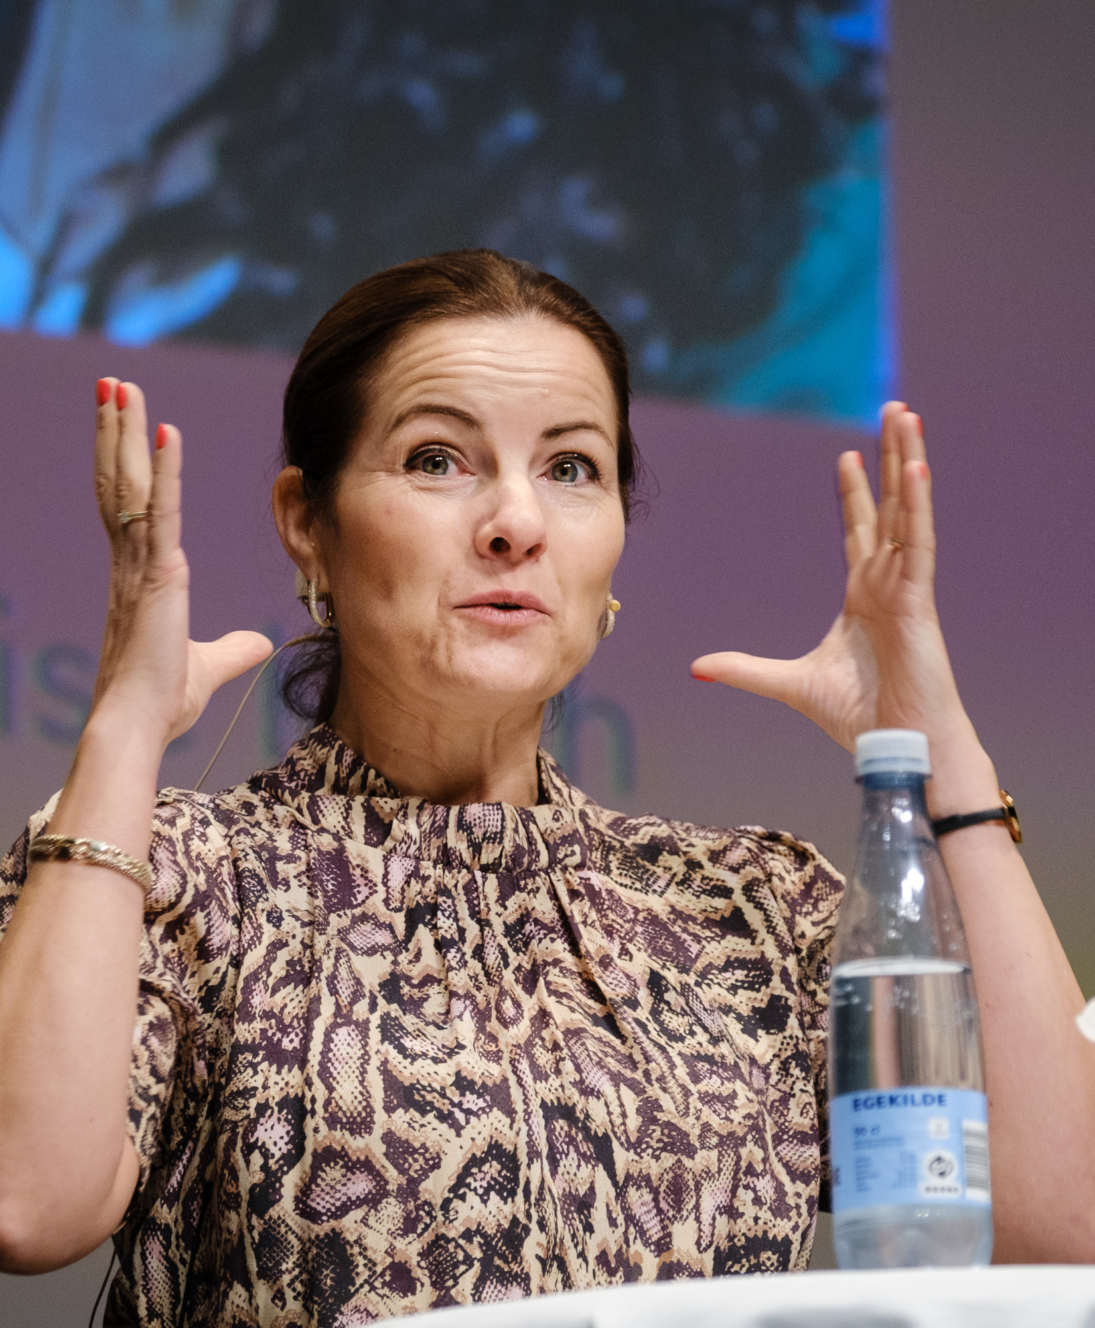
Job and career development
DM's member survey shows that there is a need to ensure both better access to skills development and development in jobs and careers.
DM believes that skills development should be seen as an integral part of any recruitment process, rather than something that is only needed at long intervals or in response to specific operational needs. Opportunities for job and career development are crucial for the development of the public sector and ensuring the employability of individuals.
Presentation for discussion:
How can we integrate skills development and career development opportunities as an integral part of employment, so that everyone has the opportunity for professional development throughout their working lives?
Is there a need for larger competence development funds, or can we get more commitment from individual workplaces to ensure continuous skills development?
Is the system of central competence development funds working?
Is the need for skills development being met in both the short and long term?
Notes:
Skills development and on-the-job development are essential factors in ensuring that individuals can do their best work. It is also important both to ensure the individual’s employability and thus lifetime earnings, and to ensure that society's investment in education is maintained. Individual employers need the right skills to get the job done, and we need to ensure that employers are committed to maintaining the skills of their workforce, so that the employers' requirements for skills are not met simply by hiring new staff. It can be a long way from graduation to retirement, and up-to-date skills are necessary in order to seize new opportunities in the labour market.
In OK21, we got competence development funds in the municipal and regional area, so all 3 public sector areas are now covered by competence development funds.

Slide 13
Conditions for fixed-term employees
DM’s member survey shows that members see a need for increased focus on restricting the use of fixed-term contracts.
DM believes that the challenges of fixed-term employment need to be addressed in the public sector. Everyone has a right to safe and fair conditions.
Presentation for discussion:
How can fixed-term employees get better access to permanent employment?
How can fixed-term workers get the same opportunities for skills development, parental leave, pay progression and pension cover as permanent colleagues?
What can be done within your area to improve the conditions for fixed-term employees?
Notes:
Temporary employment must be reduced as far as possible through better access to permanent employment
Where there is a real need for fixed-term contracts, there also needs to be a discussion about how to minimise the inconveniences of fixed-term contracts.

Slide 14
Terms and conditions for managers
DM believes that attractive career opportunities and conditions are crucial to attract good managers to public sector workplaces.
Presentation for discussion:
How do we ensure that public sector workplaces have attractive career opportunities and conditions for managers?
How do we ensure attractive wages for managers at all levels
How can management expertise be strengthened?
Notes:
DM organises both managers and employees, and it is a common interest to ensure that workplaces are well managed and that cooperation in workplaces is characterised by trust. Therefore, public sector collective bargaining shall also support the fact that good managers are essential to ensure attractive workplaces.
Good leadership is important for the entire workplace – the better the management, the better the workplace. In order to exercise good leadership, managers also need good development and working conditions. There are good reasons therefore to focus on the framework for good governance.

Slide 15

Parental leave and equality
DM believes that a more equal distribution of parental leave will help to increase gender equality, by encouraging men to take more parental leave and reduce the gender pay gap, as well as strengthening women's career opportunities.
Presentation for discussion:
What should be the balance between earmarked pay entitlements and pay entitlements that parents can distribute themselves?
Do you experience other equality problems in your workplace?
Notes:
The new parental leave rules that came into force on 2 August 2022 mean that an important step has been taken towards parental equality. In principle, both parents have an equal right to parental benefits after the birth (24 weeks each), so it would be obvious to consider an extended wage entitlement for the father/co-mother in the collective bargaining negotiations – ideally a wage entitlement covering all the weeks of parental leave benefits, so that there is full wages for both parents throughout their parental leave.
The Danish labour market is very gender-segregated and women are a majority in the public sector. An increase in earmarked wage entitlements for fathers could help to increase the attractiveness of public sector employment for men.

Slide 16
Terms and conditions for seniors
DM's member survey shows that the members see a need for flexibility in the arrangement of senior working life in order to retain seniors. But also that there should be a focus on hiring more seniors, so that people do not become unemployed at the end of their working lives
DM believes that it is necessary to develop conditions and frameworks that make it attractive and realistic for academics to remain in their jobs as seniors. Both out of consideration for the individual's ability to decide for themselves when it is time to retire, but also out of consideration for society's need for labour.
Presentation for discussion:
How can the public sector develop a framework for seniors that makes it attractive for academics to remain in their jobs as seniors?
How do we ensure that skills, not age, are the determining factor in recruitment?
Notes:
It is paradoxical that although there is a demand in society for labour, job-seeking seniors can find it difficult to find a job. We can see that seniors in the private labour market are switching to part-time work, while seniors in the public sector labour market are retiring. We need to examine how the public sector labour market can better accommodate the flexibility needs and wishes of older people. This could include part-time work, but also the timing of working hours and the balance between development and routine.

Slide 17
Timetable for gathering and deciding on demands for OK24 in DM
Demand gathering, discussion with members and union representatives on themes for OK24, weeks 3–9, 2023
Discussion of themes and demands in DM sector boards, committees and relevant networks, weeks 11–14, 2023
Deadline for submitting demands to the Collective Bargaining Committee, 5 April 2023
The collective bargaining committee discusses DM's demands for OK24, 10 May and 6 June 2023
The Executive Board approves DM's demands for OK24, after which the demands will be sent to the Danish Confederation of Professional Associations (Akademikerne)
Notes:
All the demands from AC's 28 member organisations will be gathered after DM's demands are submitted to AC.
The 28 organisations (DM, Djøf, IDA, etc.) will discuss the demands and decide which demands should be included in AC's overall package of demands.
Demands relating to the entire public sector labour market (e.g. parental leave and union representative rules) will be coordinated with the collective bargaining community.
Demands will be exchanged with the employers (State, Regions, Municipalities) just before Christmas 2023.
The negotiations will take place in January and February 2024.
Hopefully there will be a result by the end of February.
The result will be put to a vote of the members.
If the members agree, the new collective agreements will enter into force on 1 April 2024.

